Slide 1
Bio& 242 A&P
Unit 4 / Lecture 1A

Slide 2
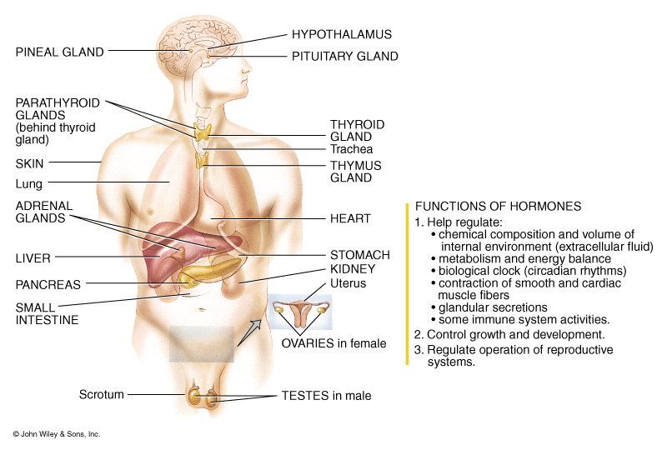
Introduction to the Endocrine System

Slide 3
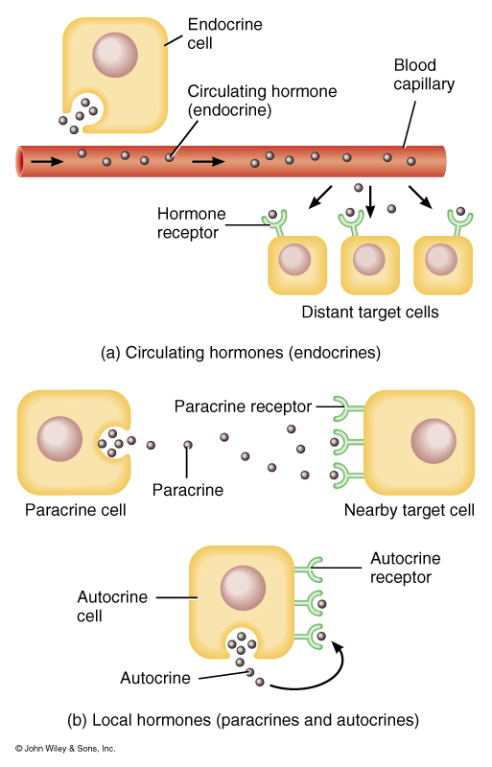
Patterns of Hormone Action
Target cells or tissue:
Specific cells affected by a hormone
Endocrine: circulated by blood to target cells
Paracrine: Hormones that affect neighboring cells
Autocrine: Hormones that act on the cells that secrete them

Slide 4
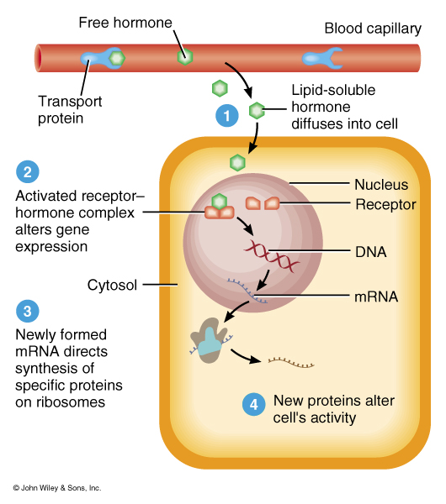
Mechanism of Action for lipid-soluble or steroid Endocrine hormones
Lipid-Soluble Hormones
Aldosterone
Calcitriol
Testosterone
Estrogen
Progesterone
T3 & T4

Slide 5
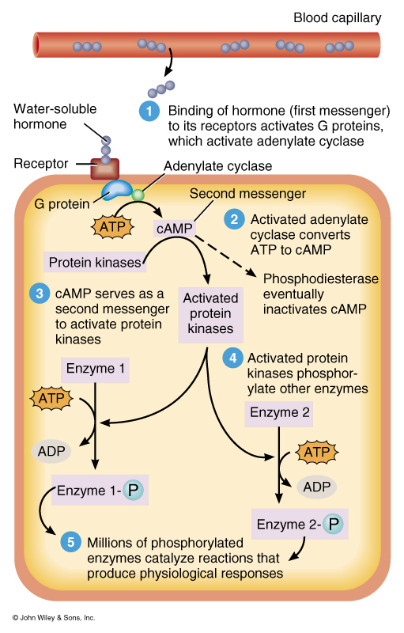
Mechanism of action for water-soluble Hormones
Catecholamines
Epinephrine
Norepinephrine
Peptides/Proteins
All Hypothalamic releasing/inhibiting
hormones
Oxytocin
ADH

Slide 6
Mechanism of action for water-soluble Hormones
Anterior Pituitary Hormones
Human Growth hormone
TSH
ACTH
FSH
LH
Prolactin
MSH

Slide 7
Mechanism of action for water-soluble Hormones
Parathyroid Hormone
Parathyroid Hormone
Pancreas Hormones
Insulin
Glucagon
Somatostatin
Pancreatic polypeptide
Calcitonin

Slide 8
Hormone Interactions
Down-regulation:
decrease in target cell receptors when excessive hormone is present
Up-regulation:
Increase in target cell receptors when there is a deficiency of hormone
Permissive Effect:
When the actions of a hormone on target cells requires a simultaneous or recent exposure to a second hormone

Slide 9
Hormone Interactions
Synergistic Effect:
Two hormones acting together have a greater or more extensive effect.
Antagonistic Effect:
One hormone opposes the action of another hormone.

Slide 10
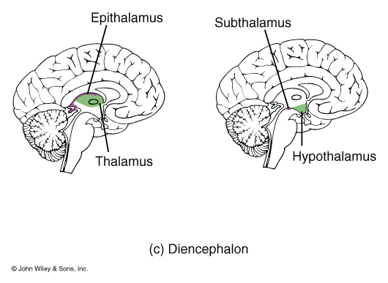
Action of the Hypothalamus as the “Master” Gland
Hypothalamus:
Controls the activity of the pituitary gland by releasing hormones called releasing or inhibiting hormones

Slide 11
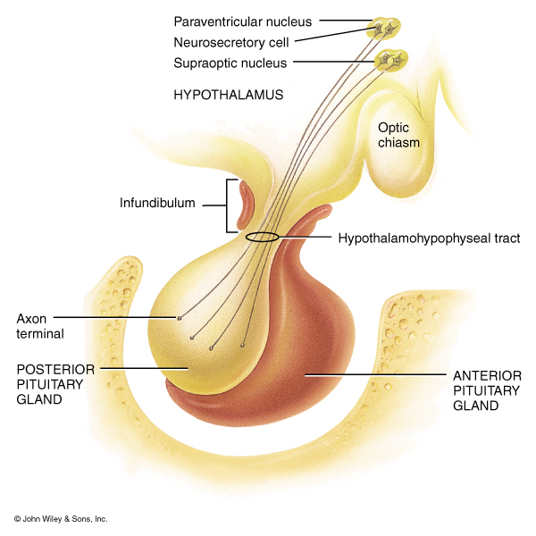
Actions of the Posterior Pituitary or Neurohypophysis
Neurohypophysis
does not synthesize hormones, however, it stores and releases two hormones produced by the neurosecretory cells of the hypothalamus
ADH
Oxytocin

Slide 12
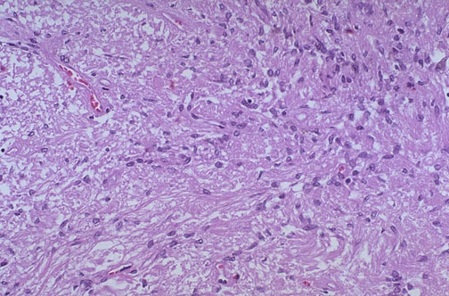
Histology of the Neurohypophysis
Neurohypophysis
Shown here, resembles neural tissue, with glial or supportive cells and nerve fibers which are part of the hypothalamohypophyseal tract

Slide 13
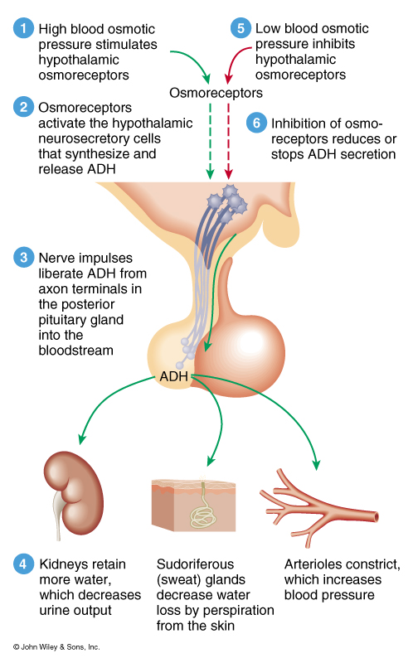
Actions and Regulation of ADH

Slide 14
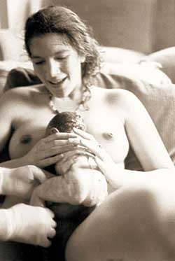
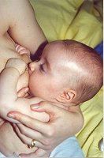
Major Actions of Oxytocin
Stimulates contraction of smooth muscle cells of the uterus during childbirth
Stimulates contraction of myoepithelial cells in the breast to cause milk letdown

Slide 15
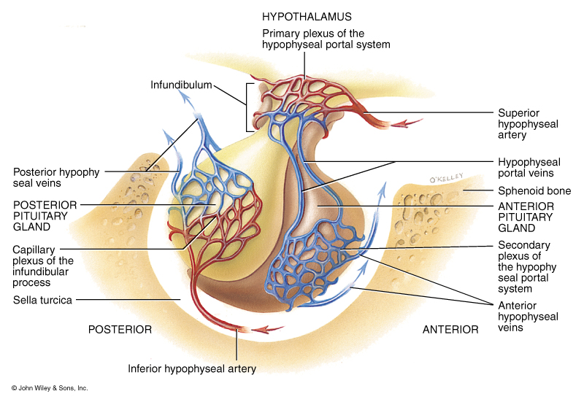
Hormones Released from the Anterior Pituitary or Adenohypophysis
Somatotrophs:
Human growth hormone or somatotrophin (hGH)
Hypothalamic control:
hGH releasing hormone (GHRH)
hGH inhibiting hormone (GHIH)
Thyrotrophs:
Thyroid-stimulating hormone (TSH)
Hypothalamic control:
Thyrotropin releasing hormone (TRH)
(GHIH)

Slide 16
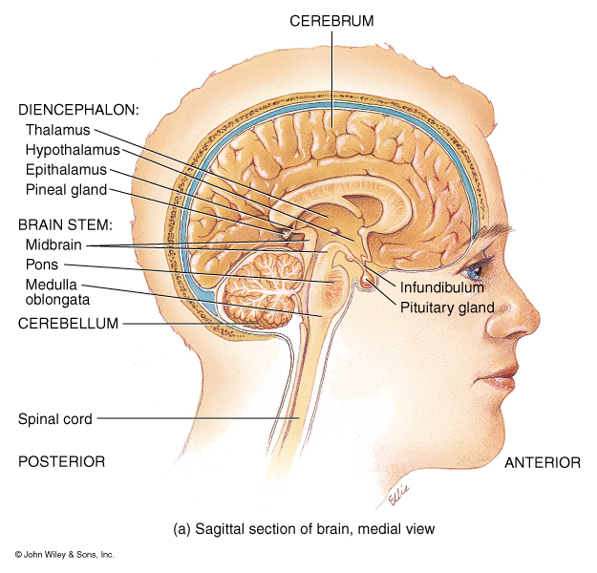
Hormones Released from the Anterior Pituitary or Adenohypophysis
Gonadotrophs:
Follicle-stimulating hormone (FSH)
Luteinizing hormone (LH)
Hypothalamic control:
Gonadotropic releasing hormone (GnRH)
Lactotrophs:
Prolactin (PRL)
Hypothalamic control:
Prolactin releasing hormone (PRH) and TRH
Prolactin inhibiting hormone PIH or dopamine

Slide 17
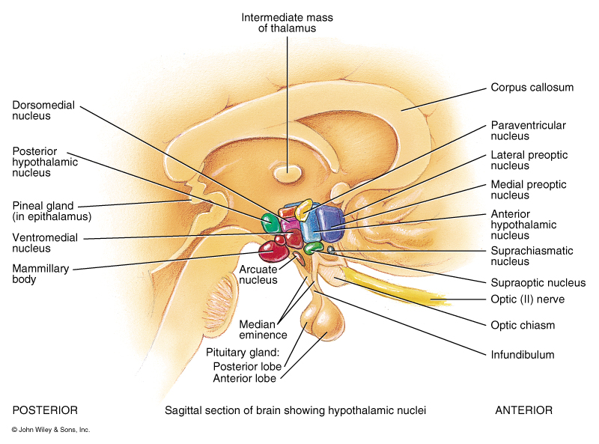
Hormones Released from the Anterior Pituitary or Adenohypophysis
Corticotrophs:
Adrenocorticotropic hormone (ACTH)
Melanocyte-stimulating hormone (MSH)
Hypothalamic control:
Corticotropic releasing hormone (CRH)
For MSH inhibition dopamine

Slide 18
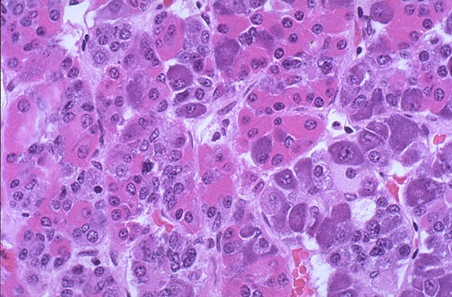
Histology of the Adenohypophysis
  The pink cells are acidophils
  1. Somatotrophs
  Human Growth Hormone (hGH)
  2. Lactotrophs
  Prolactin (PRL)

Slide 19
Histology of the Adenohypophysis
  The dark purple or blue cells are basophils:
  1. Corticotrophs
  Adrenocorticotropic Hormone (ACTH)
  Melanocyte-stimulating Hormone (MSH)
  2. Thyrotrophs
  thyroid stimulating hormone (TSH)
  3. Gonadotrophs
  follicle stimulating hormone (FSH)
  Luteinizing hormone (LH)

Slide 20
Histology of the Adenohypophysis
  The pale-staining chromophobes have few cytoplasmic granules, but may have secretory activity

Slide 21
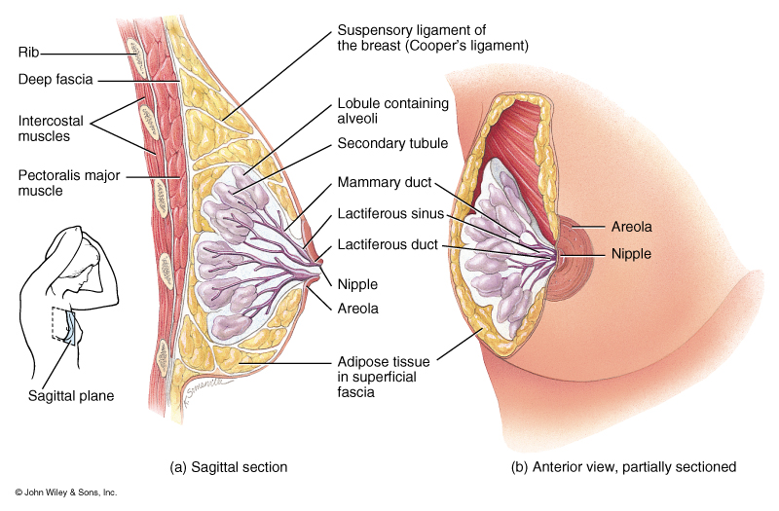
Actions of Prolactin
Hypothalamic control:
PRH, PIH
Released by lactotrophs of the adenohypophysis
Target Tissue: Lactiferous cells for the breast
Effect: Initiates and maintains milk production in breasts that have been prepared by other hormones

Slide 22
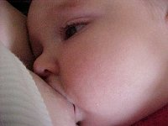
Actions of Prolactin
Also along with progesterone causes breast tenderness before menstruation.
Hyposecretion: Decreased milk production
Hypersecretion:
Females: galactorrhea
and amenorrhea
Males: erectile dysfunction or impotence and production of fluid from the nipple

Slide 23
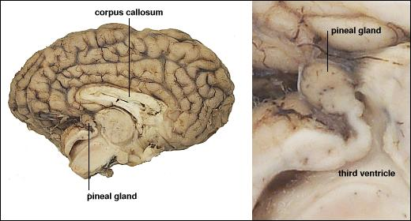
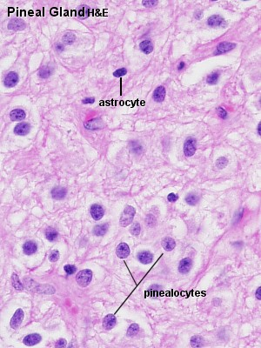
Pineal Gland
Descartes regarded it as the principal seat of the soul and the place in which all our thoughts are formed

Slide 24
Pineal Gland
Melatonin:
Synthesis is regulated by light, due to a rate-limiting enzyme in melatonin synthesis - serotonin N-acetyltransferase.
Increases at night and decreases during day time.
Regulates circadian rhythms, a roughly-24-hour cycle in the physiological processes .
Induces Sleep
Hypersecretion: Sleepiness, SAD, Jet Lag
Hyposecretion: Insomnia

Slide 25
Pineal Gland
Serotonin:
Synthesized in the pineal gland, blood platelets, the digestive tract, and the brain.
Acts both as a chemical messenger that transmits nerve signals between nerve cells and that causes blood vessels to narrow.
Involved in the inhibition of anger and aggression.
Helps with the regulation of body temperature, mood, sleep, vomiting, sexuality, appetite, and (?) love.
Hypersecretion: Serotonin syndrome a rare, but potentially life-threatening adverse drug reaction that results from intentional self-poisoning, therapeutic drug use, or inadvertent interactions between drugs
Hyposecretion: Insomnia, (?) increase in anger and aggression.

